Slide 2
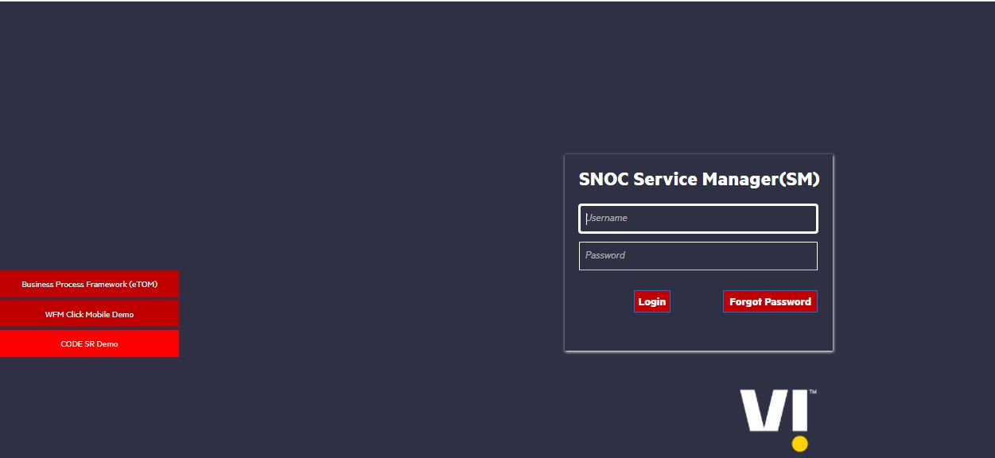
HPSM Login Page
Login URL: http://10.19.32.29:9090/SM960/index.do?lang=en

Slide 3
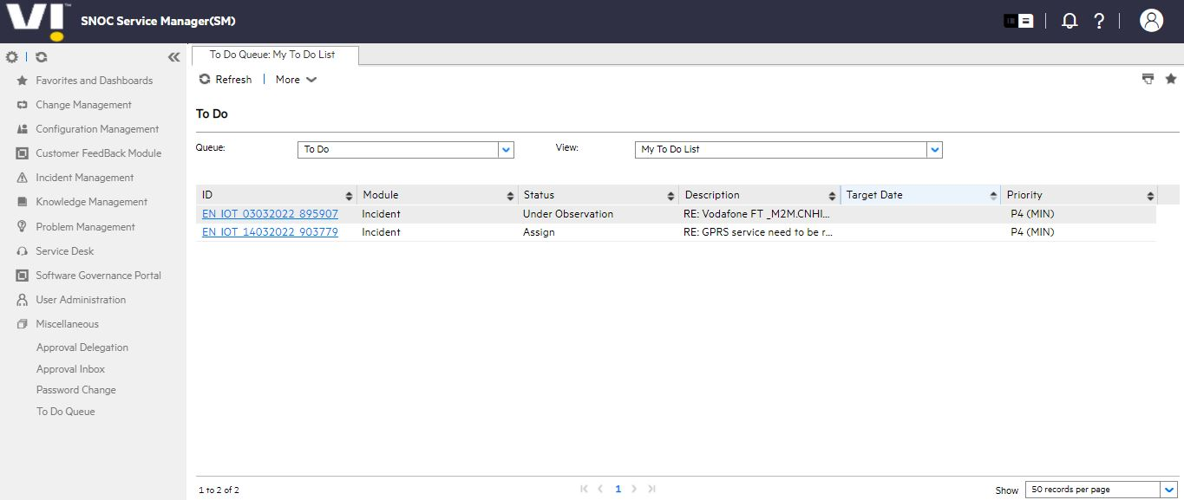
HPSM Home Page

Slide 4

CISCO Finesse
Login URL: https://ndc3vapafin7a.inroot.in:8445/desktop/

Slide 5
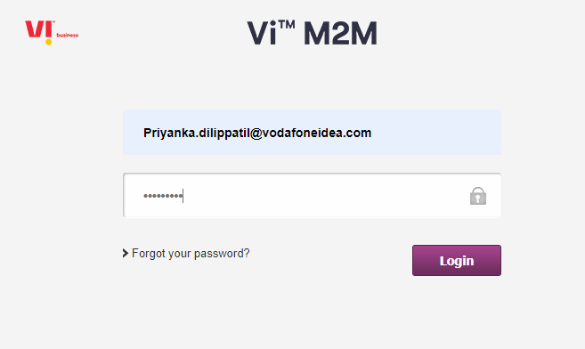
GDSP
Login URL : iotportal.myvi.in

Slide 6
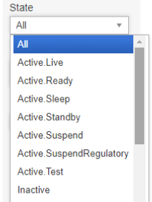
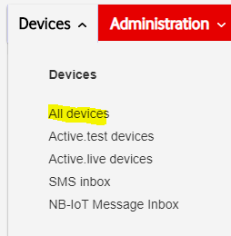
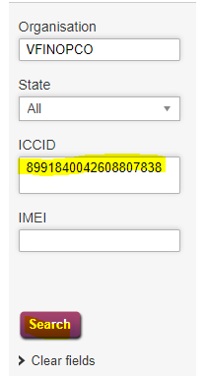

States in GDSP and Customer details
How to check customer details

Slide 7
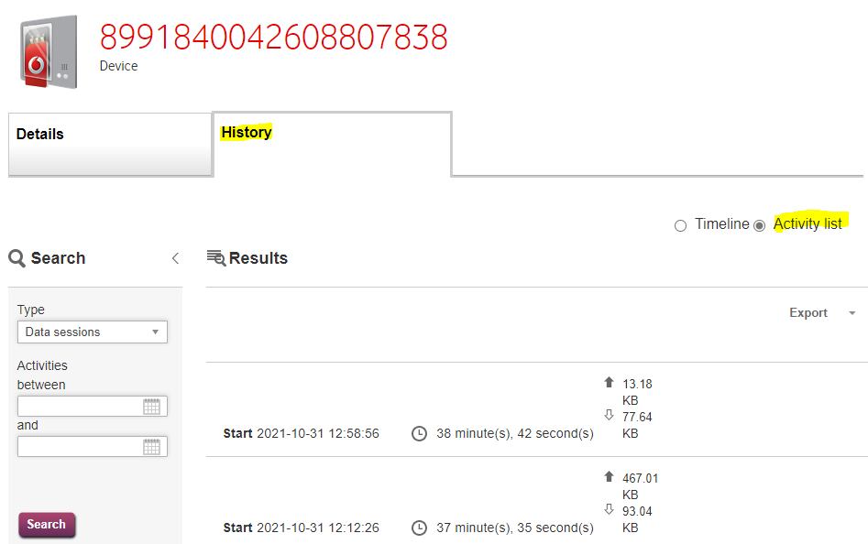
To check history of data usage

Slide 8
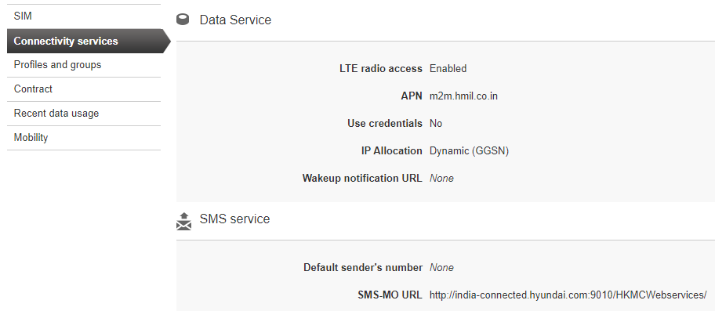
To check APN and solution type

Slide 9
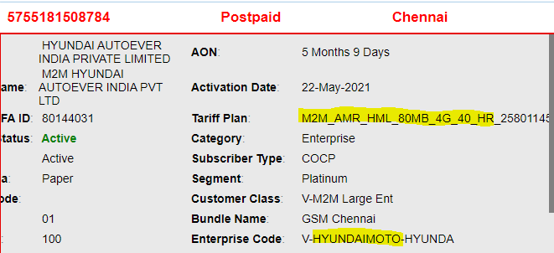
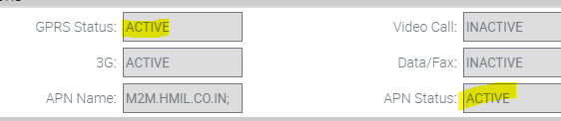
Steps to check GDSP solution.
There are two plans.
1)HR : High Rental
2)LR : Low Rental
Under High Rental(HR), sim services will be in active and it will be in below state.
Active.Live
Active.Ready
SCRM View
GDSP View

Slide 10
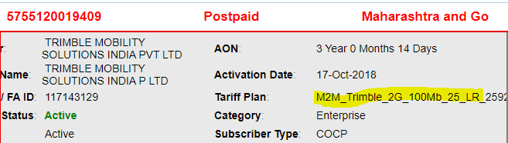
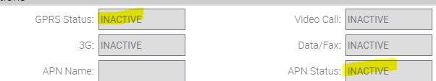

Steps to check GDSP solution.
Under Low Rental (LR), sim services will be in inactive and it will be in below state.
Active.Suspend
SCRM View
GDSP View

Slide 11

SCRM Login Page
SCRM- East : https://sumeru-east.vodafoneidea.in:6100/ecommunications_enu/start.swe?
SCRM- South : https://sumeru-south.vodafoneidea.in:6100/ecommunications_enu/start.swe?

Slide 12
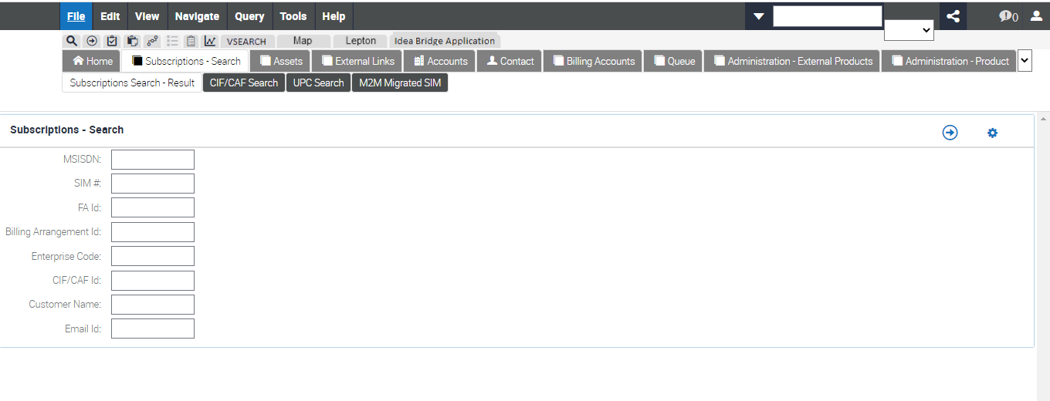
SCRM Home Page

Slide 13
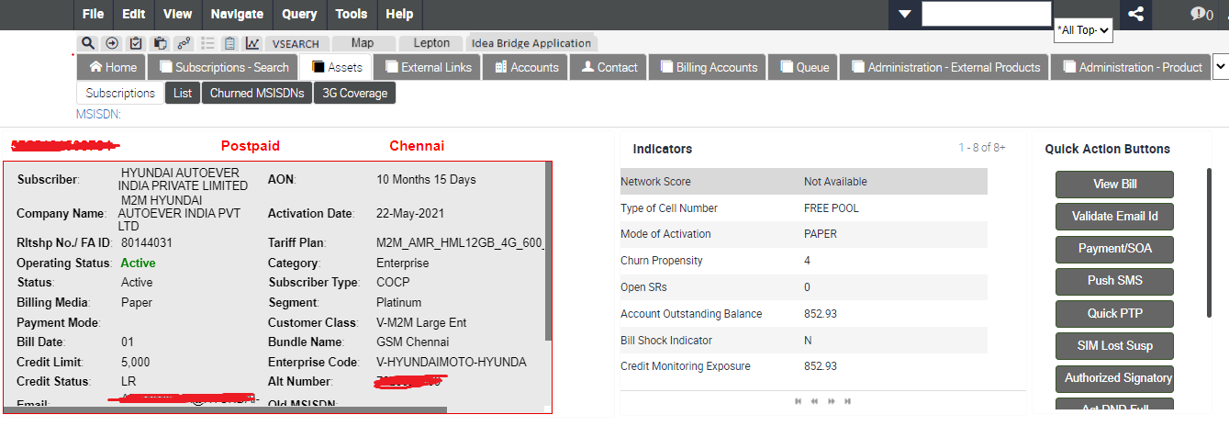
SCRM Dashboard

Slide 14
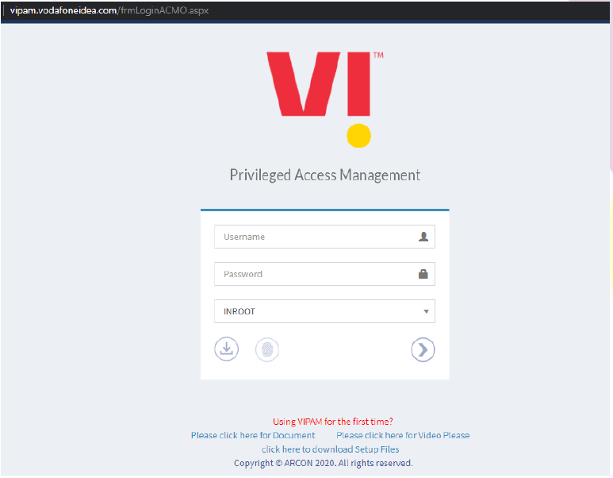
VIPAM Login Page
Login URL: https://vipam.vodafoneidea.com/frmLoginACMO.aspx
Login to application with your AD credentials.
Enter the domain ‘Username’ and ‘Password’.
Select Domain ‘INROOT’
Click on Login Button

Slide 15
VIPAM Home Page
Once you are successfully logged in you will get the below is the welcome screen:

Slide 16
Thank you !

